Slide 1
Week Two – Class One

Slide 2

Encapsulation
Encapsulation is a process of combining data members and functions in a single unit called class.
This is to prevent the access to the data directly, the access to them is provided through the functions of the class.
It is one of the popular feature of Object Oriented Programming(OOPs) that helps in data hiding.

Slide 3
Real Life Example Of Encapsulation
In a company there are different sections like the accounts section, finance section, sales section etc. The finance section handles all the financial transactions and keep records of all the data related to finance. Similarly, the sales section handles all the sales related activities and keep records of all the sales. Now there may arise a situation when for some reason an official from finance section needs all the data about sales in a particular month. In this case, he is not allowed to directly access the data of sales section. He will first have to contact some other officer in the sales section and then request him to give the particular data.

Slide 4
Real life example
In a company, two software projects are going on with two different teams. One team requires data from the other team. But this team cannot access the data from the other team because they do not have the appropriate permissions. This is Encapsulation

Slide 5
Encapsulation cont.
The meaning of Encapsulation, is to make sure that "sensitive" data is hidden from users.
To achieve this, you must declare class variables/attributes as private (cannot be accessed from outside the class).
If you want others to read or modify the value of a private member, you can provide public get and set methods.

Slide 6

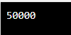
Encapsulation-Access Private Members
To access a private attribute, use public "get" and "set" methods:
The salary attribute is private, which have restricted access.
The public setSalary() method takes a parameter (s) and assigns it to the salary attribute (salary = s).
The public getSalary() method returns the value of the private salary attribute.
Inside main(), we create an object of the Employee class. Now we can use the setSalary() method to set the value of the private attribute to 50000. Then we call the getSalary() method on the object to return the value

Slide 7
Types Of Encapsulation
There are three types of encapsulations:
Member Variable Encapsulation
In this type of encapsulation, all the data members are declared as private.
Function Encapsulation
In this type of encapsulation, some of the member functions are declared as private. The constructor is public.
Class Encapsulation
In this type of encapsulation, all a class is declared as private. This is mostly done during nested classes.

Slide 8
Why Encapsulation
Encapsulation is necessary to keep the details about an object hidden from the users of that object.
Details of an object are stored in its data members (member bables).
This is the reason we make all the member variables of a class private and most of the member functions public.
Member variables are made private so that these cannot be directly accessed from outside the class (to hide the details of any object of that class like how the data about the object is implemented) and so most member functions are made public to allow the users to access the data members through those functions.
It is considered good practice to declare your class attributes as private (as often as you can). Encapsulation ensures better control of your data, because you (or others) can change one part of the code without affecting other parts
Increased security of data

Slide 9
Benefits of Encapsulation
Help protect our data. A client cannot change an Account's balance if we encapsulate it.
Encapsulated classes are easier to change. We can change the privacy of the data according to the requirement without changing the whole program by using access modifiers (public, private, protected). For example, if a data member is declared private and we wish to make it directly accessible from anywhere outside the class, we just need to replace the specifier private by public.

Slide 10
Abstraction
Data abstraction is one of the most essential and important feature of object oriented programming in C++.
Abstraction means displaying only essential information and hiding the details. Data abstraction refers to providing only essential information about the data to the outside world, hiding the background details or implementation.

Slide 11
Abstraction in OOP
Abstraction is selecting data from a larger pool to show only the relevant details to the object.
Abstraction is a way to cope with complexity.
Principle of abstraction:
“Capture only those details about an object that are relevant to current perspective”

Slide 12


Example – Abstraction
Driver’s View
Engineer’s View

Slide 13

Encapsulation vs Abstraction
S.NO | ABSTRACTION | ENCAPSULATION
1. | Abstraction is the process or method of gaining the information. | While encapsulation is the process or method to contain the information.
2. | In abstraction, problems are solved at the design or interface level. | While in encapsulation, problems are solved at the implementation level.
3. | Abstraction is the method of hiding the unwanted information. | Whereas encapsulation is a method to hide the data in a single entity or unit along with a method to protect information from outside.
4. | We can implement abstraction using abstract class and interfaces. | Whereas encapsulation can be implemented using by access modifier i.e. private, protected and public.
5. | In abstraction, implementation complexities are hidden using abstract classes and interfaces. | While in encapsulation, the data is hidden using methods of getters and setters.
6. | The objects that help to perform abstraction are encapsulated. | Whereas the objects that result in encapsulation need not be abstracted.

Slide 14
Abstraction
Example: The solution architect is the person who creates the high-level abstract technical design of the entire solution, and this design is then handed over to the the development team for implementation. Here, solution architect acts as a abstract and development team acts as a Encapsulation.
Encapsulation means-hiding data like using getter and setter etc.
Abstraction means- hiding implementation using abstract class and interfaces

Slide 15
Introduction To Objects Into Real World
Object
instance of class
State of an object
Static and Dynamic
Behavior of an object
Behavior is how an object acts & reacts, in terms of its state change and message passing.
Identity of an object
Employee - Empid, Name, Gender, Mobile_No
Responsibility of an object
Responsibility of an object is the role it serves within the system.

Slide 16
Getter/Setter Functions
Getters and setters are as the name suggests functions that are created to set values and to fetch i.e. get values. These vastly work with classes a lot and are famous ways of doing the same in the coding paradigm

Slide 17
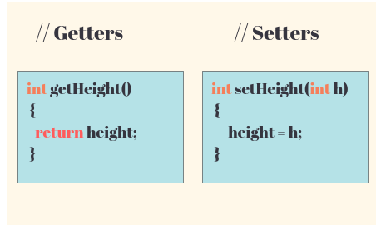
Getter/Setter Functions

Slide 18
Function and it ReturnType
Int Function(){
Return 2;
}
Int Main(){
Function();
}

Slide 19
Case-Study
Write the definition for a class called Rectangle that has floating point data members length and width. The class has the following member functions: void setlength(float) to set the length data member void setwidth(float) to set the width data member float area() to calculate and return the area of the rectangle void show() to display the length and width of the rectangle

Slide 20
Exercise
Write the definitions for each of the above member functions.
Write main function to create two rectangle objects. Set the length and width of the first rectangle to 5 and 2.5. Set the length and width of the second rectangle to 5 and 18.9. Display each rectangle and its area. check whether the two Rectangles have the same area and print a message indicating the result

Slide 21
Example
Write the definition for a class called complex that has floating point data members for storing real and imaginary parts. The class has the following member functions: void set(float, float) to set the specified value in object void disp() to display complex number object complex sum(complex) to sum two complex numbers & return complex number 1. Write the definitions for each of the above member functions. 2. Write main function to create three complex number objects. Set the value in two objects and call sum() to calculate sum and assign it in third object. Display all complex numbers.

Slide 22
Object v/s Classes
BASIS FOR COMPARISON | OBJECT | CLASS
Definition | An instance of a class is known as Object. | A template or blueprint with which objects are created is known as Class.
Type of entity | Physical | Logical
Creation | Object is invoked by. | Class is declared by using class keyword.
Memory allocation | Creation of object consumes memory. | The formation of a class doesn't allocate memory.

Slide 23
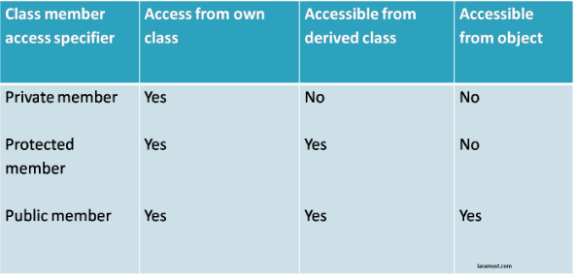
Access Control
Public
Private
Protected

Slide 24
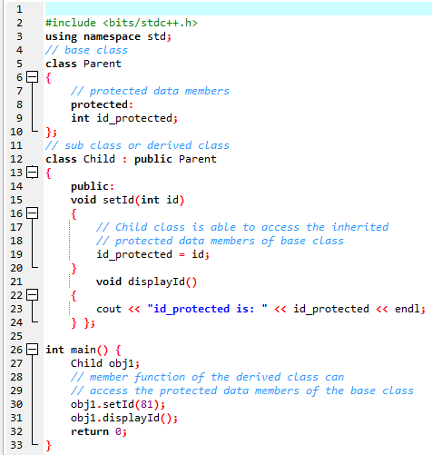
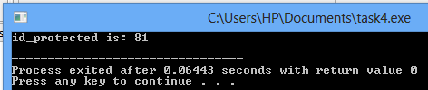
Protected-Modifier
Protected access modifier is similar to that of private access modifiers, the difference is that the class member declared as Protected are inaccessible outside the class but they can be accessed by any subclass(derived class) of that class.

Slide 25
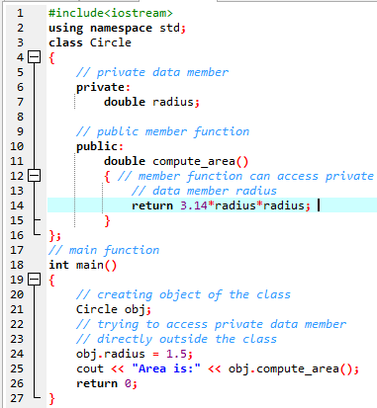
Private Modifier
The class members declared as private can be accessed only by the functions inside the class. They are not allowed to be accessed directly by any object or function outside the class.
The output of above program will be a compile time error because we are not allowed to access the private data members of a class directly outside the class.

Slide 26
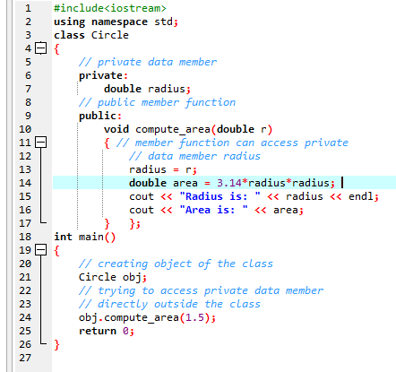
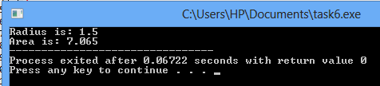
Private Modifier

Slide 27
Constructor
A constructor is a member function of a class which initializes objects of a class.
It has the same name of the class.
It must be a public member.
No Return Values.
Default constructors are called when constructors are not defined for the classes.

Slide 28
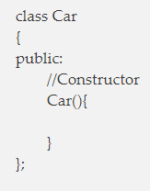
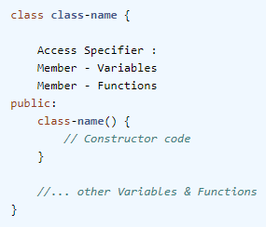
Constructor cont'd
If we do not specify a constructor, C++ compiler generates a default constructor for us (expects no parameters and has an empty body).
For example, in below class Car, constructor name will also be Car().

Slide 29
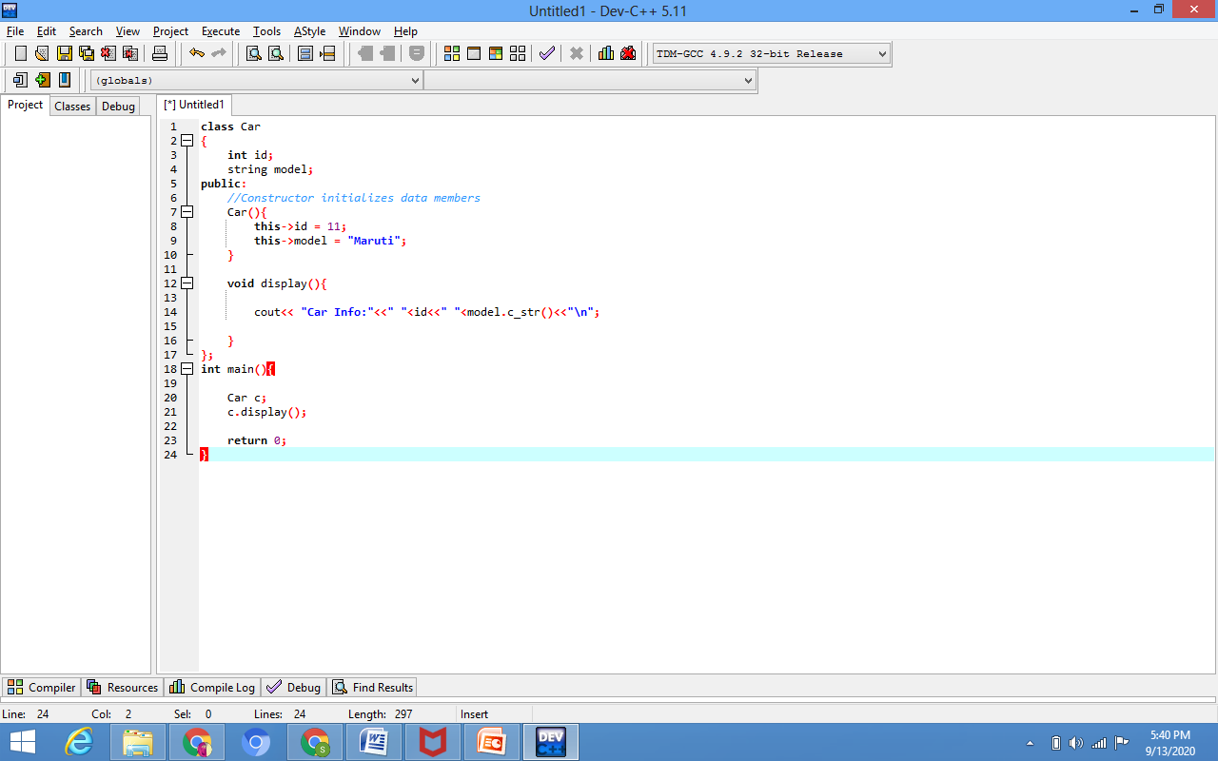
Advantages
The main purpose of the class constructor in C++ programming is to construct an object of the class. In other word, it is used to initialize all class data members.
For example, in below class, constructor Car () is initializing data members with default values. And, when we create the object of a class, this constructor will always be called.

Slide 30
Excercise
Write a program and input two integers in main and pass them to default constructor of the class. Show the result of the additon of two numbers.

Slide 31
Generalized Class
- The class that only exhibits the common features of its objects.
Examples:
- ANIMAL
- BIRDS
- HUMAN

Slide 32
Specialized Class
- The class that exhibits different or unique features (behaviors)
ANIMAL (Generalized)
Specialized:
Mammals
Cats
Dog
ANIMAL
WILD PET
CAT CAT
Lion Streat Cat Persian Siamese

Slide 33
Type of classes
There are four distinct types of classes which are differentiated based on implementation. They are:
Base Classes/ Concrete Base class
Derived Classes / Concrete Derived class
Abstract Class

Slide 34
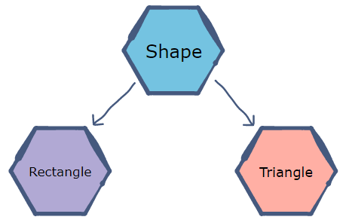
Abstract Class
Abstract class in C++ is a class that has at least one pure virtual function (i.e., a function that has no definition). The classes inheriting the abstract class must provide a definition for the pure virtual function; otherwise, the subclass would become an abstract class itself.
The purpose of an abstract class (often referred to as an ABC) is to provide an appropriate base class from which other classes can inherit.
For example, a Vehicle parent class with Truck and Motorbike inheriting from it is an abstraction that easily allows more vehicles to be added.
Abstract classes are essential to providing an abstraction to the code to make it reusable and extendable.

Slide 35
Virtual member function
A virtual member function for which no implementation is given is called a pure virtual function .
Virtual void fun() = 0;
Sometimes implementation of all function cannot be provided in a base class because we don’t know the implementation. Such a class is called abstract class.

Slide 36
Concrete Class
A concrete class is a class that can be used to create an object. An abstract class cannot be used to create an object (you must extend an abstract class and make a concrete class to be able to then create an object).
You can instantiate a concrete class.
A concrete class doesn’t have any abstract methods.
It is not mandatory to inherit a concrete class to use it.

Slide 37
Sructure
structure is another user defined data type available in C/C++ that allows to combine data items of different kinds.
Structures are used to represent a record. Suppose you want to keep track of your books in a library. You might want to track the following attributes about each book −
Title
Author
Subject
Book ID

Slide 38
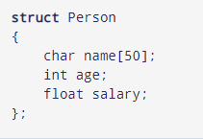
Syntax of structure
The struct keyword defines a structure type followed by an identifier (name of the structure).
Then inside the curly braces, you can declare one or more members (declare variables inside curly braces) of that structure.
For example:

Slide 39
C Structure vs C++ Structure
1. Member functions inside structure:
Structures in C cannot have member functions inside structure but Structures in C++ can have member functions along with data members.
struct person_str {
string name; int age; //constructor person_str() {
name = "default";
age = 77;}

Slide 40
C Structure vs C++ Structure
2. Direct Initialization:
We cannot directly initialize structure data members in C but we can do it in C++
#include <stdio.h>
struct Record {
int x = 7;
};
// Driver Program
int main()
{
struct Record s;
printf("%d", s.x);
return 0;
}
/* Output : Compiler Error
6:8: error: expected ':', ', ', ';', '}' or
'__attribute__' before '=' token
int x = 7;
^
In function 'main': */

Slide 41
C Structure vs C++ Structure
3. Using struct keyword:
In C, we need to use struct to declare a struct variable. In C++, struct is not necessary. For example, let there be a structure for Record. In C, we must use “struct Record” for Record variables. In C++, we need not use struct and using ‘Record‘ only would work.
#include <iostream>
using namespace std;
struct Record {
int x = 7;
};
// Driver Program
int main()
{
Record s;
cout << s.x << endl;
return 0;
}
struct Record {
int x = 7;
};
// Driver Program
int main()
{
struct Record s;
printf("%d", s.x);
return 0;
}

Slide 42
C Structure vs C++ Structure
4. Static Members: C structures cannot have static members but is allowed in C++.
5. Access Modifiers: C structures do not have access modifiers as these modifiers are not supported by the language. C++ structures can have this concept as it is inbuilt in the language.
6. Constructor creation in structure: Structures in C cannot have constructor inside structure but Structures in C++ can have Constructor creation.

Slide 43
Structure vs Classes
In C++, a structure is the same as a class except for a few differences.
The most important of them is security.
A Structure is not secure and cannot hide its implementation details from the end user while a class is secure and can hide its programming and designing details.
Following are the points that expound on this difference:
What if we forget to put an access modifier before the first field?
1) Data Members of a class are private by default and members of a struct are public by default.
struct Robot { OR class Robot {
float locX; float locX;

Slide 44
Structure vs Classes
Class
Structure
Classes are of reference types. | Structs are of value types.
All the reference types are allocated on heap memory. | All the value types are allocated on stack memory.
Class has limitless features. | Struct has limited features.
Class is generally used in large programs. | Struct are used in small programs.
A Class can inherit from another class. | A Struct is not allowed to inherit from another struct or class.

Slide 45
Primitive Data VS Derived Data Types
Fundamental Data Types | Derived Data Types
Fundamental data type is also called primitive data type. These are the basic data types. | Derived data type is the aggregation of fundamental data type.
character, integer, float, and void are fundamental data types. | Pointers, arrays, structures and unions are derived data type

Slide 46
C++ data Types
Data Type | Meaning | Size (in Bytes)
int | Integer | 2 or 4
float | Floating-point | 4
double | Double Floating-point | 8
char | Character | 1
wchar_t | Wide Character | 2
bool | Boolean | 1
void | Empty | 0
int salary = 85000;
float area = 64.74;
double volume = 134.64534;
char test = 'h'
bool cond = false;

Slide 47
Example 1: Get ASCII Value of a Character
#include <iostream>
using namespace std;
int main() {
char ch = 'h';
// Printing the corresponding ASCII of a character
// Notice the use of int() to get an integer
cout << "ASCII value = " << int(ch) << endl;
return 0;
}

Slide 48
Example 1: Printing a char variable
#include <iostream>
using namespace std;
int main() {
// initializing a variable
char ch = 'h';
// printing the variable
cout << "Character = " << ch << endl;
return 0;
}

Slide 49
C++ Type Modifiers
We can further modify some of the fundamental data types by using type modifiers. There are 4 type modifiers in C++. They are:
signed
unsigned
short
long
Data Type | Size (in Bytes) | Meaning
signed int | 4 | used for integers (equivalent to int)
unsigned int | 4 | can only store positive integers
short | 2 | used for small integers (range -32768 to 32767)
unsigned short | 2 | used for small positive integers (range 0 to 65,535)
long b = 4523232;
long int c = 2345342;
long double d = 233434.56343;
short d = 3434233; // Error! out of range
unsigned int a = -5; // Error! can only store positive numbers or 0

Slide 50
Typedef
Syntax:
typedef int integer;
Now, you can use integer instead of int in the program.
Consider this example:
#include using namespace std; main() { typedef int marks; marks phy = 80; marks chem = 70; cout<<"phy marks:"<
Output: phy marks:80 chem marks:70

